Slide 1

8085 Assembly: Division of Two 16-bit Numbers
Presented by: S. Dhanusri, B.E. Computer Science — II Year
This concise lecture shows how to implement 16-bit integer division on the Intel 8085 using repeated subtraction. We'll cover registers, algorithm, flowchart, full code, explanation, and a worked example.

Slide 2
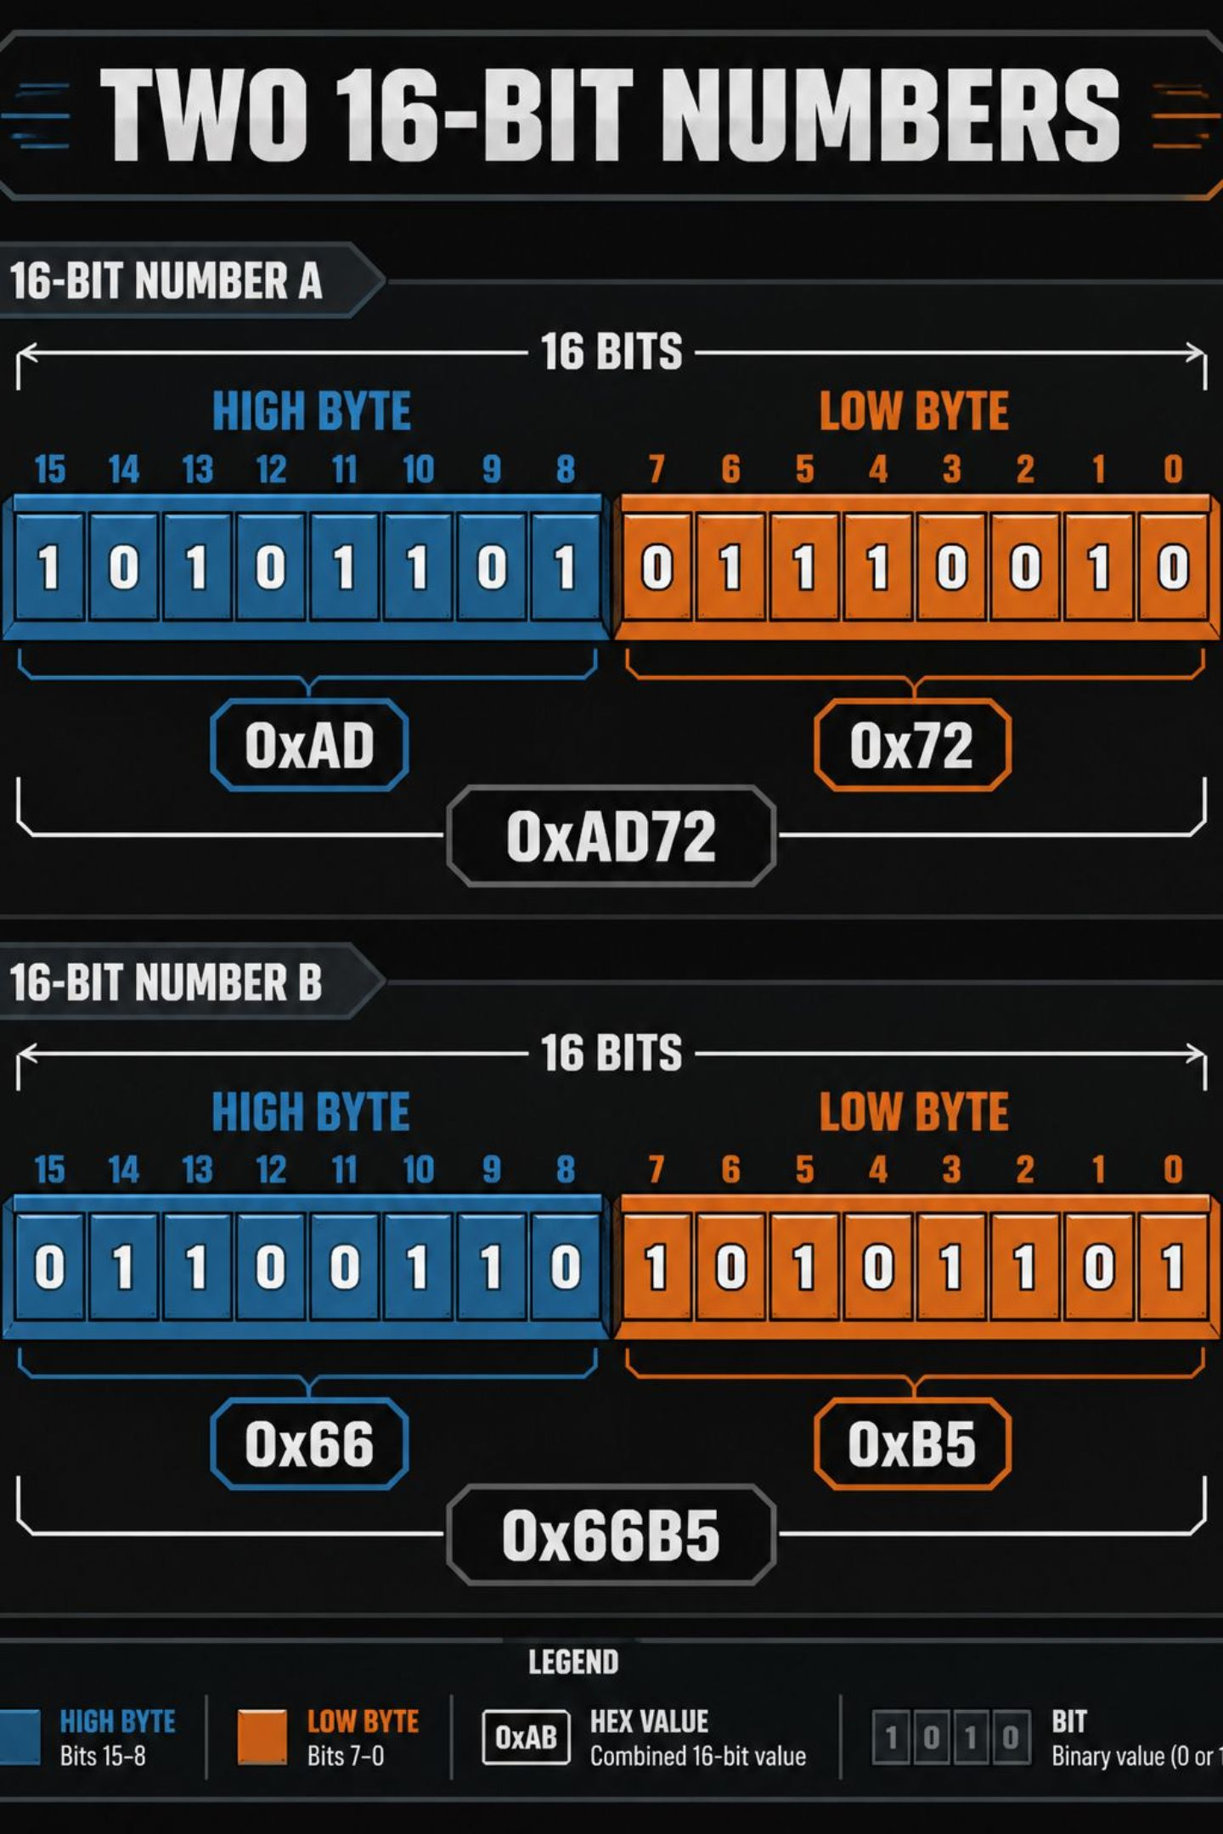
What is 16-bit Division on 8085?
Division finds the quotient and remainder when one integer is divided by another. The 8085 CPU has no DIV instruction, so we implement division by repeated subtraction. Each 16-bit operand occupies two bytes (high and low). The program subtracts the divisor from the dividend repeatedly until the dividend is smaller than the divisor.

Slide 3

Problem Statement — Aim
Write an 8085 assembly program to divide two 16-bit numbers using repeated subtraction and produce:
Quotient (16-bit)
Remainder (16-bit)
Inputs: Dividend (16-bit), Divisor (16-bit). Output: Quotient and Remainder stored in registers/memory.

Slide 4
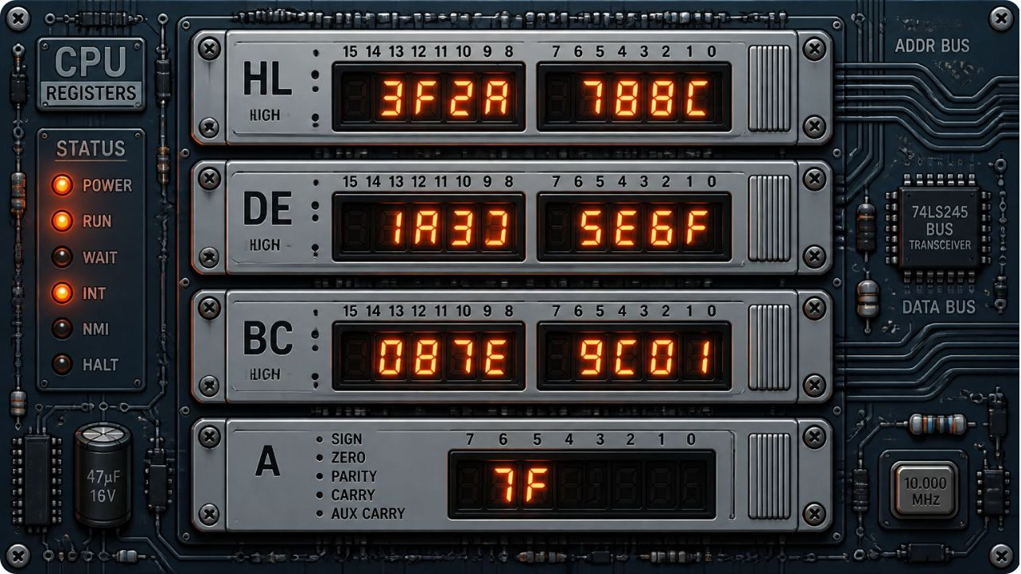
Registers Used
HL
DE
H: high byte, L: low byte — stores the 16-bit Dividend (will be decremented)
D: high byte, E: low byte — stores the 16-bit Divisor (unchanged)
BC
A & Flags
Counts successful subtractions — used as the Quotient (16-bit)
Accumulator A for byte-wise compare/subtract; Carry (borrow) and Zero flags used for conditional decisions

Slide 5
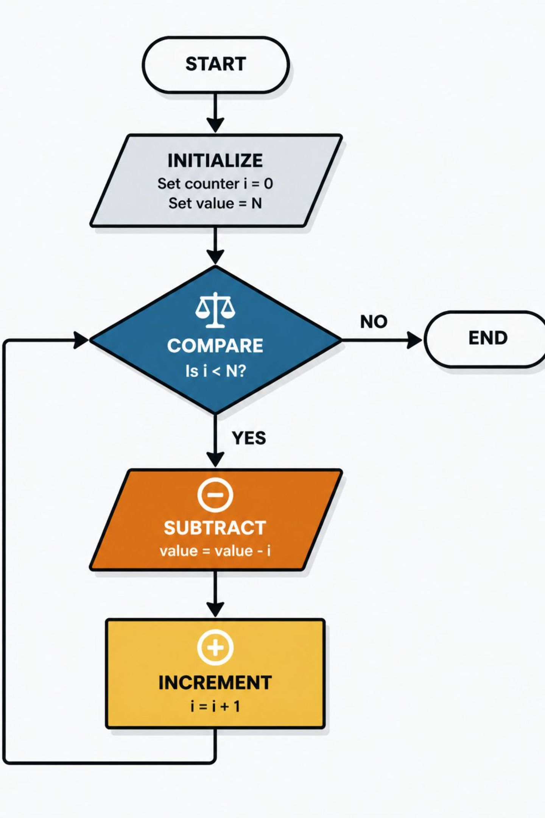
Algorithm (High-level)
Load 16-bit Dividend into HL and Divisor into DE.
Clear BC (Quotient = 0).
Compare HL with DE (compare high bytes first, then low bytes if needed).
If Dividend < Divisor, stop — HL holds remainder, BC holds quotient.
Else: HL = HL - DE (16-bit subtraction), increment BC, repeat from step 3.
Store or present Quotient (BC) and Remainder (HL).

Slide 6

Subtract & Loop
Else HL−=DE, INX B, repeat
Compare
If HL < DE then store result
Initialize Counter
Set BC = 0 for quotient
Load Values
Load dividend into HL, divisor into DE
The diagram shows the control flow: compare → conditional subtract → increment quotient counter → repeat until dividend smaller than divisor.

Slide 7
Complete Assembly Program (Repeated Subtraction)
; 16-bit division on 8085 — Dividend in HL, Divisor in DE
; Result: Quotient in BC, Remainder in HL
LXI H, 0020H ; Example: load Dividend = 0020H
LXI D, 0005H ; Example: load Divisor = 0005H
LXI B, 0000H ; Quotient = 0000H
LOOP:
MOV A, H ; Compare high bytes first
CMP D
JC DONE ; If Carry=1 then HL < DE → done
JZ CHECK_LOW ; If high bytes equal, compare low bytes
; If high byte greater, proceed to subtract
JMP SUBTRACT
CHECK_LOW:
MOV A, L
CMP E
JC DONE
; otherwise subtract (equal or greater)
SUBTRACT:
MOV A, L
SUB E ; L = L - E (byte)
MOV L, A
MOV A, H
SBB D ; H = H - D - borrow
MOV H, A
INX B ; BC = BC + 1 (increment quotient)
JMP LOOP
DONE:
; At this point:
; HL = Remainder (16-bit), BC = Quotient (16-bit)
; Program can store HL and BC to memory or display as needed
HLT
Place code in an 8085 assembler; comments clarify each step. Replace initial LXI values with runtime inputs as required.

Slide 8

Code Explanation — Key Instructions
LXI H, XXXX
Loads 16-bit Dividend into HL pair (H = high, L = low).
LXI D, YYYY
Loads 16-bit Divisor into DE pair (unchanged during loop).
LXI B, 0000
Initialises BC to zero — BC accumulates quotient (INX B increments low byte, with carry into high byte).
Compare and Borrow
CMP and JC decide if dividend < divisor. SUB and SBB perform correct 16-bit subtraction using borrow from low to high byte.
INX B
Increments BC after each successful subtraction; BC becomes the 16-bit quotient.

Slide 9
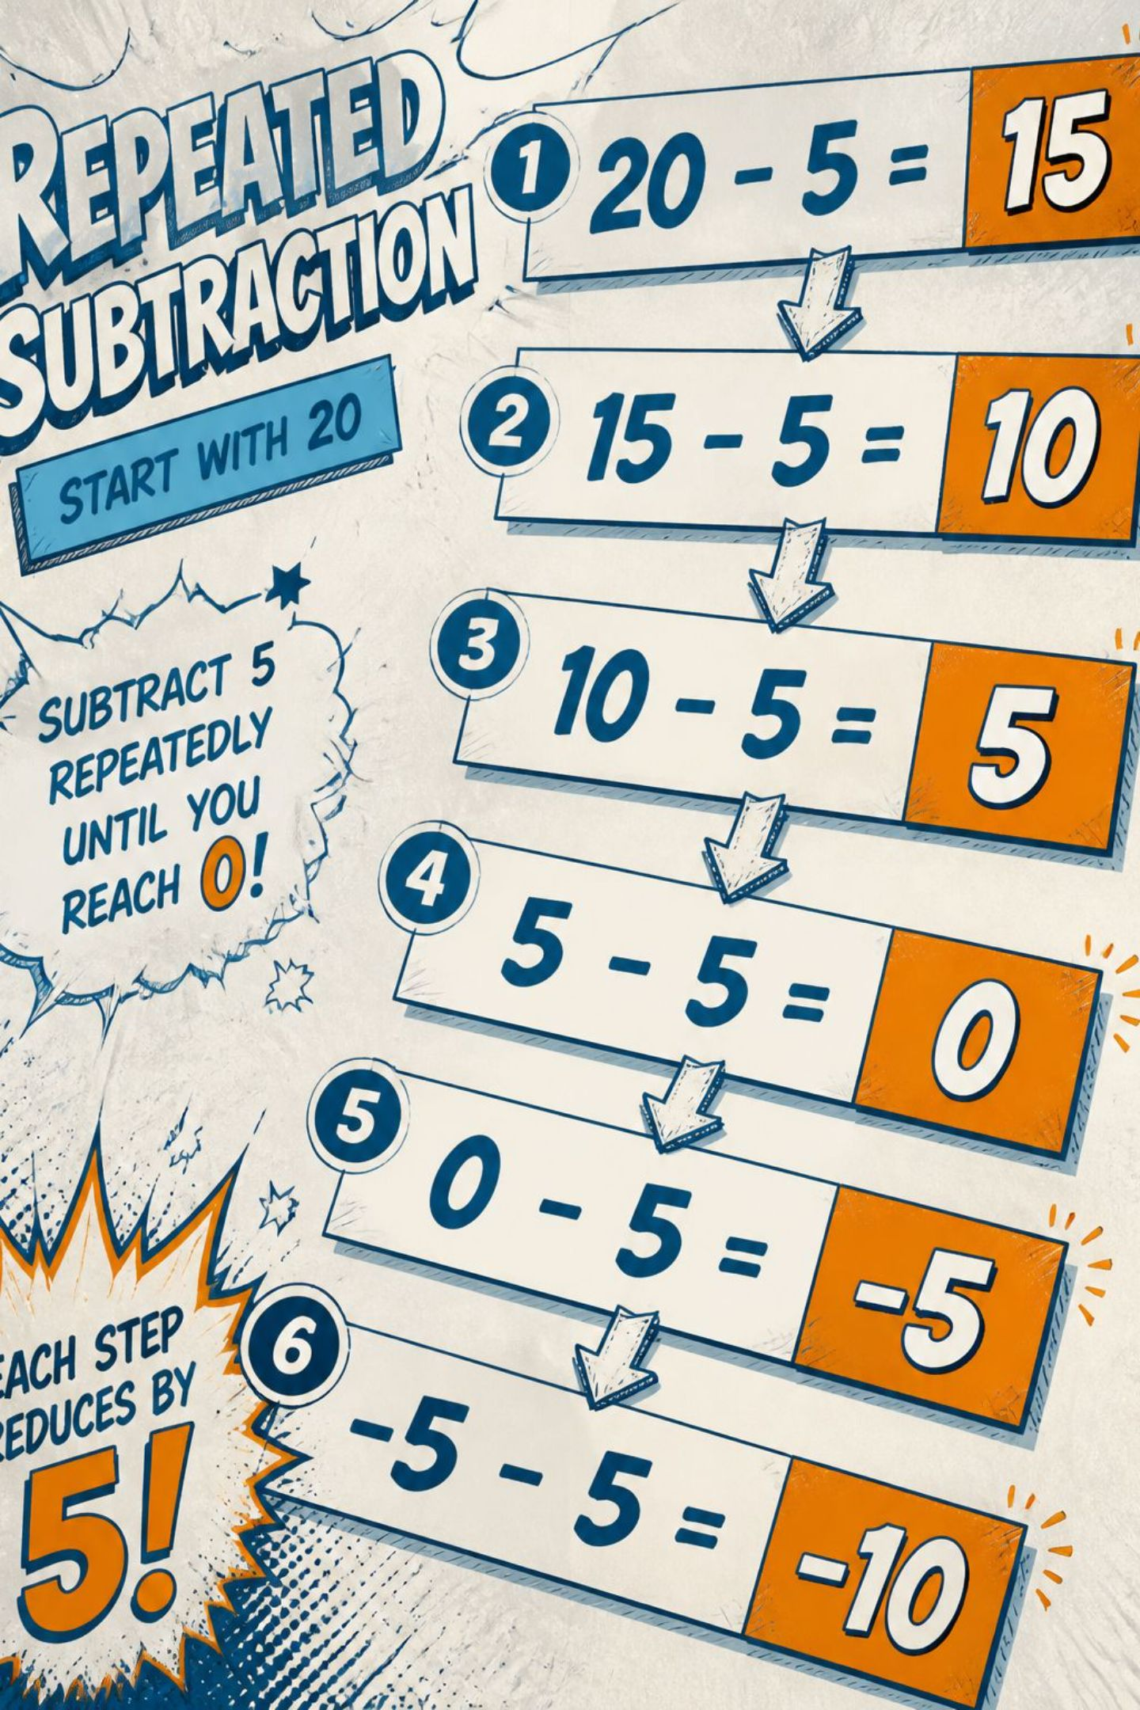
Worked Example
Example inputs: Dividend = 20 (0020H), Divisor = 5 (0005H).
20 − 5 = 15 → Quotient = 1
15 − 5 = 10 → Quotient = 2
10 − 5 = 5 → Quotient = 3
5 − 5 = 0 → Quotient = 4, Remainder = 0
Final result: Quotient = 0004H, Remainder = 0000H.

Slide 10
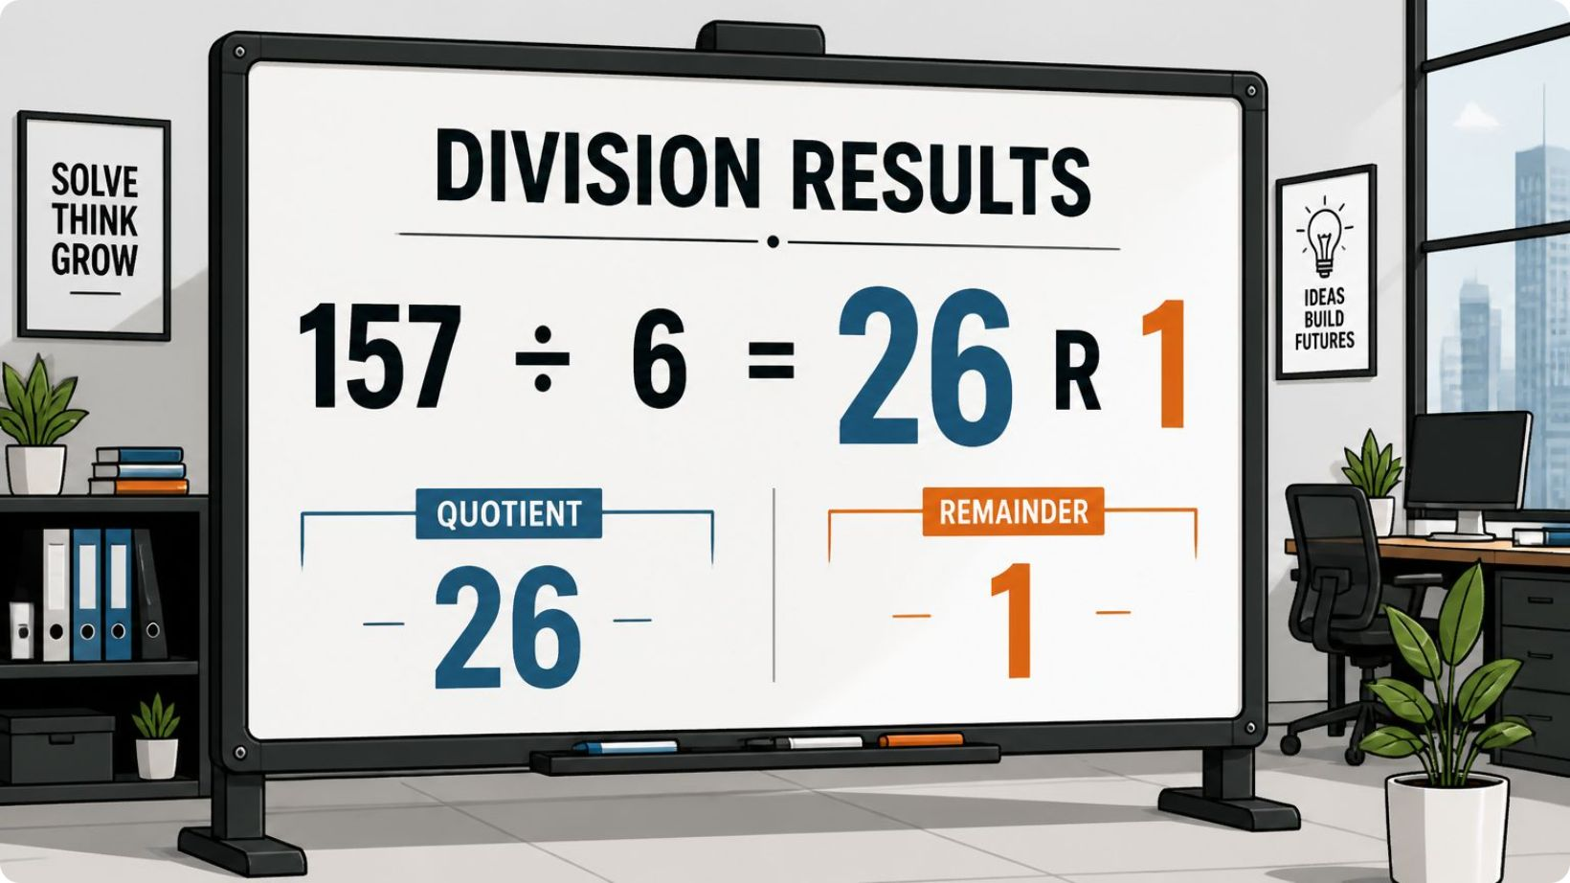

Output & Next Steps
Output for example:
Dividend = 0020H
Divisor = 0005H
Quotient = 0004H (stored in BC)
Remainder = 0000H (stored in HL)
Try different inputs (including edge cases: divisor = 0001H, divisor > dividend, and maximum 16-bit values) and test behaviour.
Extensions: implement signed division, optimise using shift-subtract (non-restoring) method, or add runtime I/O to read operands from memory or port.

